Slide 1
5.1 JavaScript Execution Environment
- The JavaScript Window object represents the
window in which the browser displays documents
- The Window object provides the largest enclosing
referencing environment for scripts
- All global variables are properties of Window
- Implicitly defined Window properties:
- document - a reference to the Document object
that the window displays
- frames - an array of references to the frames of
the document
- Every Document object has:
- forms - an array of references to the forms of the
document
- Each Form object has an elements array, which
has references to the form’s elements
- Document also has anchors, links, & images

Slide 2
5.2 The Document Object Model
- DOM 0 is supported by all JavaScript-enabled
browsers (no written specification)
- DOM 1 was released in 1998
- DOM 2 was released in 2000
- DOM 3 is the latest approved standard (2004)
- The DOM is an abstract model that defines the
interface between HTML documents and
application programs—an API
- A language that supports the DOM must have a
binding to the DOM constructs
- In the JavaScript binding, HTML elements are
represented as objects and element attributes
are represented as properties
e.g., <input type = "text" name = "address">
would be represented as an object with two
properties, type and name, with the values
"text" and "address"

Slide 3
5.2 The Document Object Model
- IE9+, FX3+, and Chrome have ways to show the
tree of a document
- See book for the necessary steps for both
browsers to get the tree of a given document
<html xmlns = "http://www.w3.org/1999/xhtml">
<head> <title> A simple table </title>
</head>
<body>
<table border = "border">
<tr>
<th> </th>
<th> Apple </th>
<th> Orange </th>
</tr>
<tr>
<th> Breakfast </th>
<td> 0 </td>
<td> 1 </td>
</tr>
</table>
</body>
</html>
→SHOW Figure 5.1 (IE9)
→SHOW Figure 5.2 (FX3)

Slide 4
5.3 Element Access in JavaScript
- There are several ways to do it
<form action = "">
<input type = "button"
name = "pushMe" />
</form>
1. DOM address
document.forms[0].elements[0]
Problem: document changes
2. Element names – requires the element and all
of its ancestors (except body) to have name
attributes
- Example:
<form name = "myForm" action = "">
<input type = "button" name = "pushMe“ />
</form>
document.myForm.pushMe
Problem: XHTML 1.1 spec doesn’t allow the
name attribute on form elements

Slide 5
5.3 Element Access in JavaScript
(continued)
3. getElementById Method (defined in DOM 1)
- Example:
<form action = "">
<input type = "button" id = "pushMe" />
</form>
document.getElementById("pushMe")
- Checkboxes and radio button have an implicit
array, which has their name
<form id = "topGroup">
<input type = "checkbox" name = "toppings"
value = "olives" />
...
<input type = "checkbox" name = "toppings"
value = "tomatoes" />
</form>
...
var numChecked = 0;
var dom = document.getElementById("topGroup");
for index = 0; index < dom.toppings.length;
index++)
if (dom.toppings[index].checked]
numChecked++;

Slide 6
5.4 Events and Event Handling
- An event is a notification that something specific
has occurred, either with the browser or an action
of the browser user
- An event handler is a script that is implicitly
executed in response to the appearance of an event
- The process of connecting an event handler to an
event is called registration
- Don’t use document.write in an event handler,
because the output may go on top of the display
Event Tag Attribute
blur onblur
change onchange
click onclick
dblclick ondblclick
focus onfocus
keydown onkeydown
keypress onkeypress
keyup onkeyup
load onload
mousedown onmousedown
mousemove onmousemove
mouseout onmouseout
mouseover onmouseover
mouseup onmouseup
reset onreset
select onselect
submit onsubmit
unload onunload

Slide 7
5.4 Events and Event Handling
(continued)
- The same attribute can appear in several different
tags
e.g., The onclick attribute can be in <a> and
<input>
- A text element gets focus in two ways:
1. When the user puts the mouse cursor over it
and presses the left button
2. When the user tabs to the element
- Event handlers can be registered in two ways:
1. By assigning the event handler script to an event
tag attribute
onclick = "alert('Mouse click!');"
onclick = "myHandler();"

Slide 8
5.5 Handling Events from Body
Elements
- Example: the load event - triggered when the
loading of a document is completed
SHOW load.html, load.js, & display
5.6 Handling Events from Button
Elements
- Plain Buttons – use the onclick property
- Radio buttons
- If the handler is registered in the markup, the
particular button that was clicked can be sent
to the handler as a parameter
e.g., if planeChoice is the name of the handler
and the value of a button is 172, use
onclick = ″planeChoice(172)″
- This is another way of choosing the clicked
button
→ SHOW radio_click.html, radio_click.js,
& display

Slide 9
5.6 Handling Events from Button
Elements (continued)
2. (second way to register an event handler)
- Assign the address of the handler function to the
event property of the JavaScript object
associated with the HTML element.
var dom = document.getElementById(″myForm″)
dom.elements[0].onclick = planeChoice;
- This registration must follow both the handler
function and the XHTML form
- If this is done for a radio button group, each
element of the array must be assigned
- In this case, the checked property of a radio
button object is used to determine whether a
button is clicked
- If the name of the buttons is planeButton
var dom = document.getElementById(″myForm″);
for (var index = 0;
index < dom.planeButton.length; index++) {
if (dom.planeButton[index].checked) {
plane = dom.planeButton[index].value;
break;
}
}
→ SHOW radio_click2.html & radio_click2.js

Slide 10
5.6 Handling Events from Button
Elements (continued)
- The disadvantage of specifying handlers by
assigning them to event properties is that there is
no way to use parameters
- The advantages of specifying handlers by
assigning them to event properties are:
1. It is good to keep HTML and JavaScript separate
2. The handler could be changed during use
5.7 Handling Events from Textbox and
Password Elements
- The Focus Event
- Can be used to detect illicit changes to a text box
by blurring the element every time the element
acquires focus
→ SHOW nochange.html & nochange.js

Slide 11
5.7 Handling Events from Textbox and
Password Elements (continued)
- Checking Form Input
- A good use of JavaScript, because it finds errors
in form input before it is sent to the server for
processing
- So, it saves both:
1. Server time, and
2. Internet time
- Things that must be done:
1. Detect the error and produce an alert message
2. Inform the user of the error and present the
correct format

Slide 12
5.7 Handling Events from Textbox and
Password Elements (continued)
- To keep the form active after the event handler is
finished, the handler must return false
- Example – comparing passwords
- The form just has two password input boxes to
get the passwords and Reset and Submit buttons
- The event handler is triggered by the Submit
button

Slide 13
5.7 Handling Events from Textbox and
Password Elements (continued)
- Handler actions:
1. If no password has been typed in the first
box, focus on that box and return false
2. If the two passwords are not the same, focus
and select the first box and return false
if they are the same, return true
--> SHOW pswd_chk.html, pswd_chk.js, pswd_chkr.js
- Another Example – Checking the format of a name
and phone number
- The event handler will be triggered by the change
event of the text boxes for the name and phone
number
- If an error is found in either, an alert message is
produced and both focus and select are called
on the text box element
→ SHOW validator.html, validator.js,
and validatorr.js

Slide 14
5.8 The DOM 2 Event Model
- Does not include DOM 0 features, but they are
still supported by browsers
- DOM 2 is modularized—one module is Events,
which has two submodules, HTMLEvents and
MouseEvents, whose interfaces are Event (blur,
change, etc.) and MouseEvent (click, mouseup, etc.)
- Event propagation
- The node of the document tree where the event
is created is called the target node
- The capturing phase (the first phase)
- Events begin at the root and move toward the
target node
- Registered and enabled event handlers at
nodes along the way are run
- The second phase is at the target node
- If there are registered but not enabled handlers
there for the event, they are run
- The third phase is the bubbling phase
- Event goes back to the root; all encountered
registered but not enabled handlers are run

Slide 15
5.8 The DOM 2 Event Model (continued)
- Not all events bubble (e.g., load and unload)
- Any handler can stop further event propagation
by calling the stopPropagation method of the Event
object
- DOM 2 model uses the Event object method,
preventDefault, to stop default operations, such
as submission of a form, if an error has been
detected
- Event handler registration is done with the
addEventListener method
- Three parameters:
1. Name of the event, as a string literal
2. The handler function
3. A Boolean value that specifies whether the
event is enabled during the capturing phase
node.addEventListener(
"change", chkName, false);

Slide 16
5.8 The DOM 2 Event Model (continued)
- A temporary handler can be created by registering
it and then unregistering it with
removeEventListener
- The currentTarget property of Event always
references the object on which the handler is
being executed
- The MouseEvent interface (a subinterface of
Event) has two properties, clientX and
clientY, that have the x and y coordinates of
the mouse cursor, relative to the upper left
corner of the browser window
- An example: A revision of validator, using the
DOM 2 event model
→ SHOW validator2.html, validator2.js, &
validator2r.js

Slide 17
5.9 The canvas Element
- Creates a rectangle into which bit-mapped graphics can be drawn using JavaScript
- Optional attributes: height, width, and id
Default value for height and width are 150 and 300 pixels
-
- The id attribute is required if something will be drawn
<canvas id = ″myCanvas″ height = ″200″ width = ″400″>
Your browser does not support the canvas element
</canvas>
- Before anything can be drawn on a canvas, a drawing context is required if (myCanvas.getContext) { var context = myCanvas.getContext(‘2d’);
// Drawing code
}

Slide 18
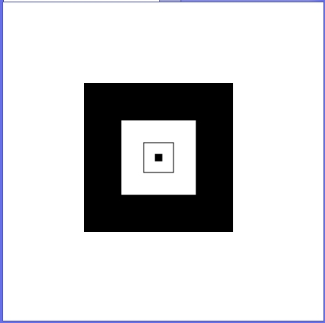
5.9 The canvas Element (continued)
- Objects are often drawn when the document
is loaded
- The only primitive shape is a rectangle, either
empty (strokeRect) or filled (fillRect)
- Four parameters, two for position and two for
size (all in pixels)
→SHOW rects.js
- Lines are drawn by creating a path with
beginPath and moveTo
The actual line is drawn with either stroke or
fill

Slide 19
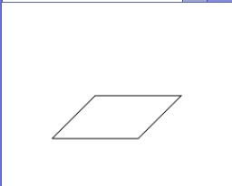
5.9 The canvas Element (continued)
→ SHOW parallel.js
- Circles and arcs are drawn with arc
- Six parameters:
- First two are the position of the center
- Third is the radius
- Fourth is the angle at which the drawing
begins
- Fifth is the angle at which the drawing ends
- The last two parameters must be in radians
- As with lines, use beginPath and either stroke
or fill

Slide 20
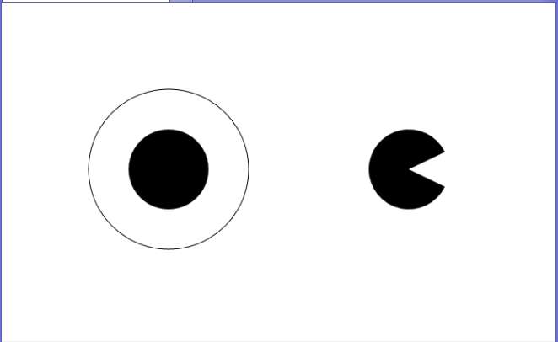
5.9 The canvas Element (continued)
→ SHOW circles.js

Slide 21
5.10 The navigator object
- Indicates which browser is being used
- Two useful properties
1. The appName property has the browser’s name
2. The appVersion property has the version #
- Microsoft has chosen to set the appVersion of IE10
to 5 (?)
- Firefox has chosen to set the appVersion of FX3
to 5.0 (?) and the name to Netscape (?)
SHOW navigate.html & navigate.js

Slide 22
5.11 DOM Tree Traversal and
Modification
- Traversal properties: parentNode, previousSibling,
nextSibling, firstChild, childNodes, and
lastChild
- For example, if there is an unordered list with the
id myList, the number of list items in the list can
be displayed with:
var dom = document.getElementById("myList");
var listItems = dom.childNodes.length;
document.write("Number of list items is: " +
listItems + "<br />");
- Modification methods: insertBefore,
replaceChild, removeChild, appendChild

